Slide 1

KGiSL INSTITUTE OF TECHNOLOGY
COIMBATORE
DEPARTMENT OF computer science & engineering
Project phase review # 00
SMART TRAFFIC MANAGEMENT
TEAM MEMBERS:
711719104075 RANJANI M
711719104087 SELLAMANI S
711719104790 SHIFA RUKSHANA B
711719104304 KIRANA S
Under the guidance of :
Ms.Aruna TN,AP/CSE

Slide 2

agenda
Objective of the project work
Existing System
Proposed System
Expected Outcome
References
Timeline

Slide 3
OBJECTIVE / ABSTRACT
As the population and number of cars in towns grow, traffic congestion is one of the most pressing problems. In addition to adding to the delay and stress experienced by drivers, traffic jams also result in higher fuel usage and air pollution. Despite appearing to be present everywhere, megacities are the ones most impacted by it. For improved signal control and efficient traffic management, the road traffic density must be calculated in real-time due to the road traffic's ever-increasing volume. One of the key elements influencing how traffic moves is the traffic controller. So, in order to better meet this growing demand, traffic management needs to be optimised. In order to calculate traffic density, our suggested system will use real-time images from the cameras at traffic intersections.

Slide 4
EXISTING SYSTEM
Traffic congestion mainly focuses on the signals failure, reduced law enforcement and improper traffic management. Because the existing foundation cannot be expanded further, the only option is to improve traffic management. As a result, the window of opportunity to effectively address traffic congestion has passed. Many ways have been developed to manage traffic and reduce congestion. Infrared sensor, inductive loop detection, video data analysis, wireless sensor network, and other are used to somewhat solve the congestion in the traffic and to manage the traffic smartly.

Slide 5
PROPOSED SYSTEM
Proposed method
As a concept, intelligent traffic systems were designed to provide traffic managers with real-time and predictive insights about traffic flow speeds and traffic congestion/incidents.
Advantages over existing method:
Reducing congestion through optimised traffic control is said to be the main influencing factor of change.
Smart traffic management uses digital technologies to manage traffic, based on real-time data to reduce congestion, and minimise emissions.

Slide 6
EXPECTED OUTCOME
Traffic light timing in real-time: The smart traffic management system helps traffic light to operate in real-time conditions. Traffic operates based on traffic congestion automatically. Safety from road accidents: Due to the deployment of this system, the chances of road accidents can be minimized.
The proposed work focuses on Smart Traffic management System using AI which will eliminate the drawbacks of the existing system such as high implementation cost, dependency on the environmental conditions, etc. The proposed system aims at effective management of traffic congestion. It is also cost effective than the existing system.

Slide 7
REFERENCE
[1] Dipak K Dash, TNN May 31, 2012. ―India loses Rs 60,000 crore due to traffic congestion: Study‖. Times Of India. http://articles.timesofindia.indiatimes.com/2012-05-31/india/31920307_1_toll-plazas-road-space-stoppage
[2] Azeem Uddin, Draft, 23 March 2009. Traffic congestion in Indian cities: Challenges of a Rising power. http://www.visionwebsite.eu/UserFiles/File/filedascaricare/Scientifci%20Partners,Papers%28Kyoto%29/Draft_koc_Azeem%20Uddin.pdf .
[3] FHWA-HRT-06-108. October 2006. Traffic Detector Handbook: Third Edition—Volume I. http://www.fhwa.dot.gov/publications/research/operations/its/06108/
[4] US7245220 B2. Jul 17, 2007. Radio frequency identification (RFID) controller. http://www.google.com/patents/US7245220
[5] FHWA-RD-96-100. July 1995. Detection Technology: IVHSVolume1.http://ntl.bts.gov/DOCS/96100/index.html

Slide 8
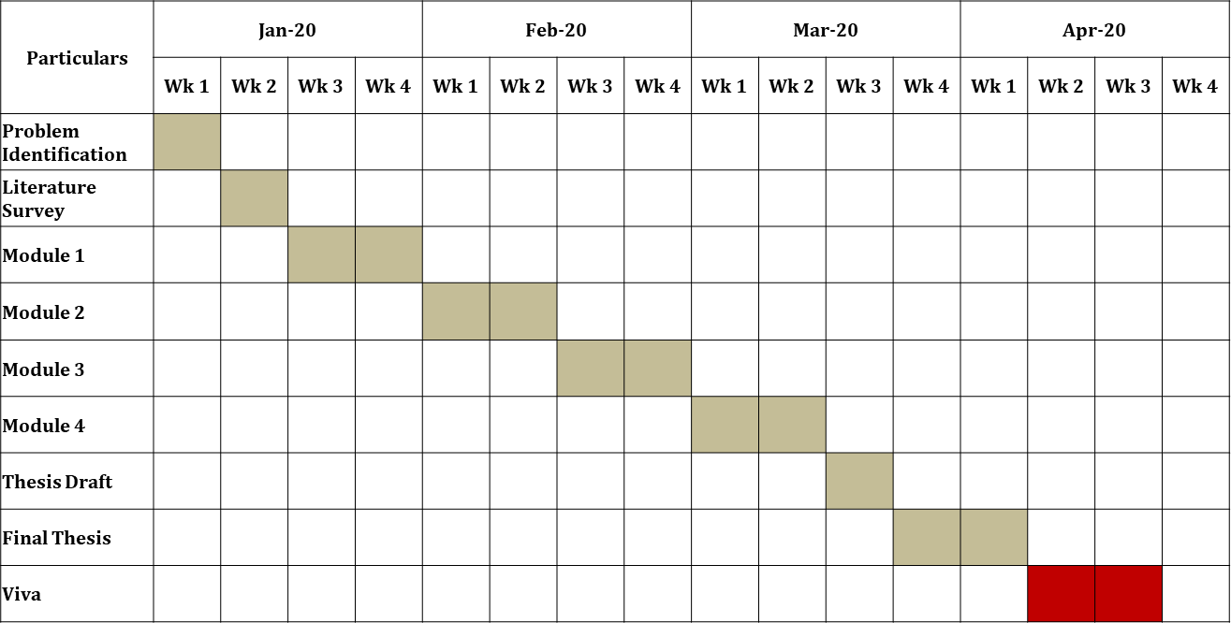
TIMELINE

Slide 9
THANK YOU

